Slide 1


From Raw Data to FAIR Data: FAIR4Health vision
FAIR Health Data Sharing Initiatives in Europe: Opportunities and Challenges for International Cooperation
Kiko Núñez
FAIR4Health Executive Coordinator
Institute of Biomedicine of Seville, Spain
Notes:
First of all, I’d like to thank the organisers for the opportunity to share with you our project. FAIR4Health started on last December and we are looking forward to establish collaborations and synergies at any level with all EU initiatives dealing with FAIR data in the health domain. So in case you are involved in other similar initiatives, please don’t hesitate to contact me at the end of the session and I will put you in contact with the coordinators to set out potential collaborations.

Slide 2

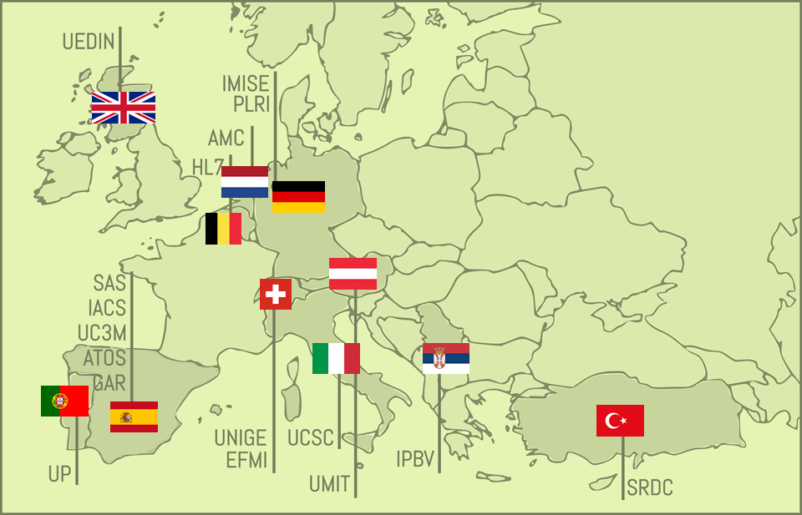
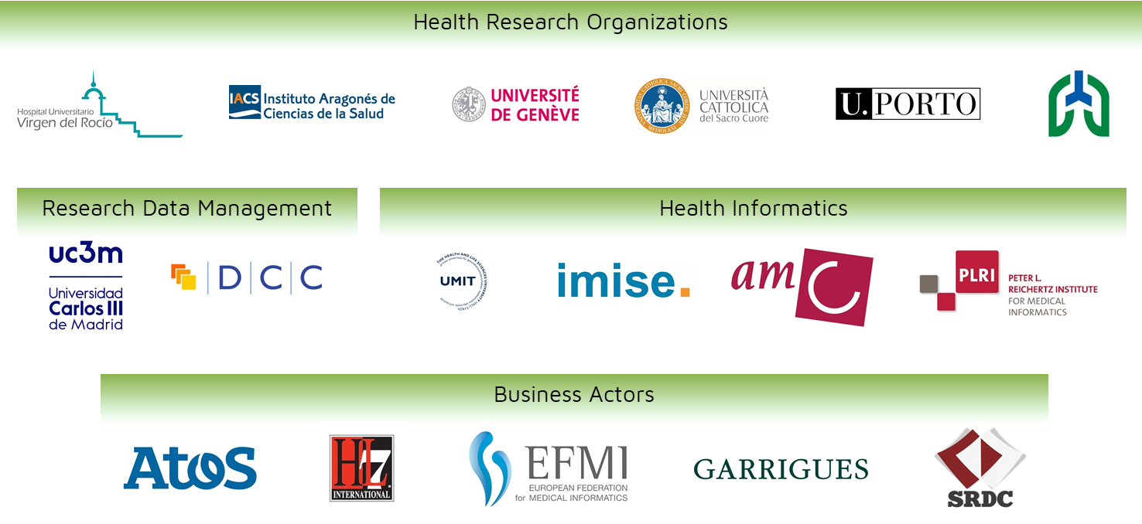

Improving Health Research in EU through FAIR data
OBJECTIVES
To facilitate and encourage the EU Health Research community to FAIRify, share and reuse their datasets derived from publicly funded research initiatives through the demonstration of the potential impact that such strategy will have on health outcomes and health research.
1. OUTREACH STRATEGY AT EU LEVEL
2. FAIR DATA CERTIFICATION ROADMAP
3. TECHNOLOGICAL PLATFORM
4. DEMONSTRATE POTENTIAL IMPACT
EC funding: 2,999,053.75 €
www.fair4health.eu
@FAIR4Health
Notes:
First of all, I’d like to thank the organisers for the opportunity to share with you our project. FAIR4Health started on last December and we are looking forward to establish collaborations and synergies at any level with all EU initiatives dealing with FAIR data in the health domain. So in case you are involved in other similar initiatives, please don’t hesitate to contact me at the end of the session and I will put you in contact with the coordinators to set out potential collaborations.

Slide 3
The FAIR Guiding Principles
FINDABLE
F1. (Meta)data are assigned a globally unique and persistent identifier
F2. Data are described with rich metadata (defined by R1 below)
F3. Metadata clearly and explicitly include the identifier of the data they describe
F4. (Meta)data are registered or indexed in a searchable resource
ACCESSIBLE
A1. (Meta)data are retrievable by their identifier using a standardised communications protocol
A1.1 The protocol is open, free, and universally implementable
A1.2 The protocol allows for an authentication and authorisation procedure, where necessary
A2. Metadata are accessible, even when the data are no longer available
INTEROPERABLE
I1. (Meta)data use a formal, accessible, shared, and broadly applicable language for knowledge representation.
I2. (Meta)data use vocabularies that follow FAIR principles
I3. (Meta)data include qualified references to other (meta)data
REUSABLE
R1. Meta(data) are richly described with a plurality of accurate and relevant attributes
R1.1. (Meta)data are released with a clear and accessible data usage license
R1.2. (Meta)data are associated with detailed provenance
R1.3. (Meta)data meet domain-relevant community standards
Wilkinson, M. D., et al. (2016). The FAIR Guiding Principles for scientific data management and stewardship. Scientific data, 3
Notes:
The overall objective of FAIR4Health is to facilitate and encourage the EU health research community to FAIRify, share and reuse their datasets derived from publicly funded research initiatives.
Specific Objective 1. To design and implement an effective outreach strategy at EU level based on trust building and shared benefit
Specific Objective 2. To produce a set of guidelines to inform a number of Research Data Alliance recommendations in order to set the foundations for a FAIR data certification roadmap to guarantee high quality of data
Specific Objective 3. To develop and validate intuitive, user-centered technological tools to enable the translation from raw (meta)data to FAIR (meta)data and support the FAIRification workflow
Specific Objective 4. To demonstrate the potential impact that the implementation of such FAIR data strategy will have in terms of health outcomes and health research through the development and validation of 2 pathfinder case studies.

Slide 4


Demonstrators
Innovative eHealth services based on FAIR data reuse
#1 To support the discovery of disease onset triggers and disease association patterns in comorbid patients and demonstrate the reproducibility of research.
#2 To develop and pilot a prediction service for 30-days readmission risk in complex chronic patients
Notes:
FAIR4Health will design, develop and demonstrate 2 pathfinder use cases, in this case they will be innovative eHealth services based on FAIR data reuse.
The first one will address the feasibility for health researchers to work with FAIRified and federated datasets to support the discovery of disease onset triggers and disease association patterns in comorbid patients, and demonstrate the reproducibility of such research.
The second one will address the development of an innovative prediction service for 30-days readmission risk in complex chronic patients making use of a privacy preserving distributed data mining approach.

Slide 5
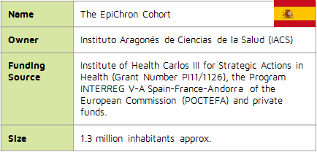
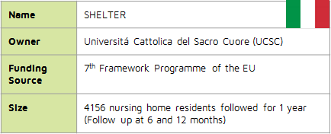
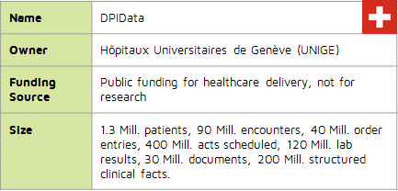
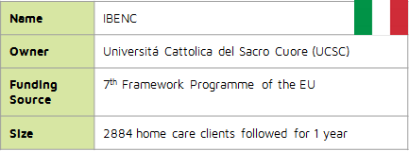
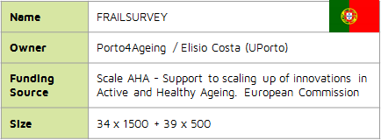
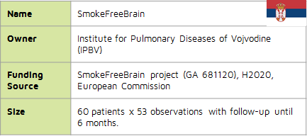

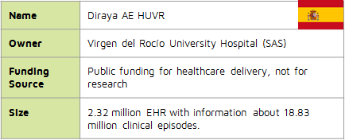
Datasets
Health and social care data from 5 million of subjects

Slide 6





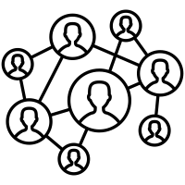



FAIRification workflow
RAW
FAIR

Slide 7

FAIRification workflow
RAW
Raw data analysis
Curation and validation
Anonymisation
License attribution
Make data linkable
Semantic modeling
Data versioning
Metadata aggregation
Archiving
FAIR

Slide 8
FAIR4Health Vision
Open Community
eHealth Provider
eHealth Provider
eHealth Provider
eHealth Services Providers
eHealth Services Providers
Healthcare Providers
Healthcare Provider
Healthcare
Providers
Healthcare Provider
Research Institution
Research Institution
Research Institution
Health Research Institutions
Health Reseach Institutions

Slide 9
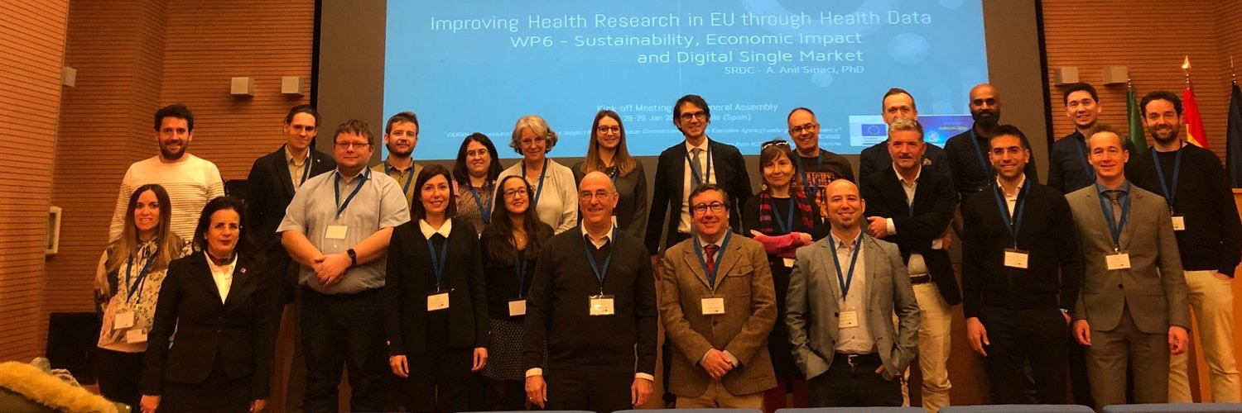
THANK YOU!
@FAIR4Health
www.FAIR4Health.eu

